Slide 1
AZ-400.00 Module 10: Design a release strategy

Slide 2
Lesson 01: Module overview

Slide 3
Module overview
Lesson 5: Choosing a deployment pattern
Lesson 1: Module overview
Lesson 2: Introduction to continuous delivery
Lesson 6: Choosing the right release management tool
Lesson 3: Release strategy recommendations
Lesson 7: Module review and takeaways
Lesson 4: Building a high-quality release pipeline

Slide 4
Learning objectives
After completing this module, students will be able to:
Differentiate between a release and a deployment
Describe the principle of release gates and how to deal with release notes and documentation
Define the components of a release pipeline
Explain deployment patterns, both in the traditional sense and in the modern sense
Explain things to consider when designing your release strategy
Choose a release management tool
Classify a release versus a release process, and outline how to control the quality of both

Slide 5
Lesson 02: Introduction to continuous delivery

Slide 6
Traditional IT company
A fair amount of hotfixes and change requests for production
Many scope changes during a project
Lots of unplanned work due to technical debt (environment drift, poor quality, handoffs)
Business involved but not attached to IT

Slide 7
Moving to continuous delivery

Slide 8

IT is the business

Slide 9
What is continuous delivery
The eight principles of continuous delivery:
The process for releasing/deploying software MUST be repeatable and reliable
Done means “released”
Keep everything in source control
Improve continuously
Everybody has responsibility for the release process
If somethings difficult or painful, do it more often
Automate everything!
Build quality in!

Slide 10
Releases and deployments
Release and deployment are often coupled
Release is not the same as a deployment
Separate that in functional and technical release:
Functional release is exposing features to customers
Technical release is deploying functionality

Slide 11
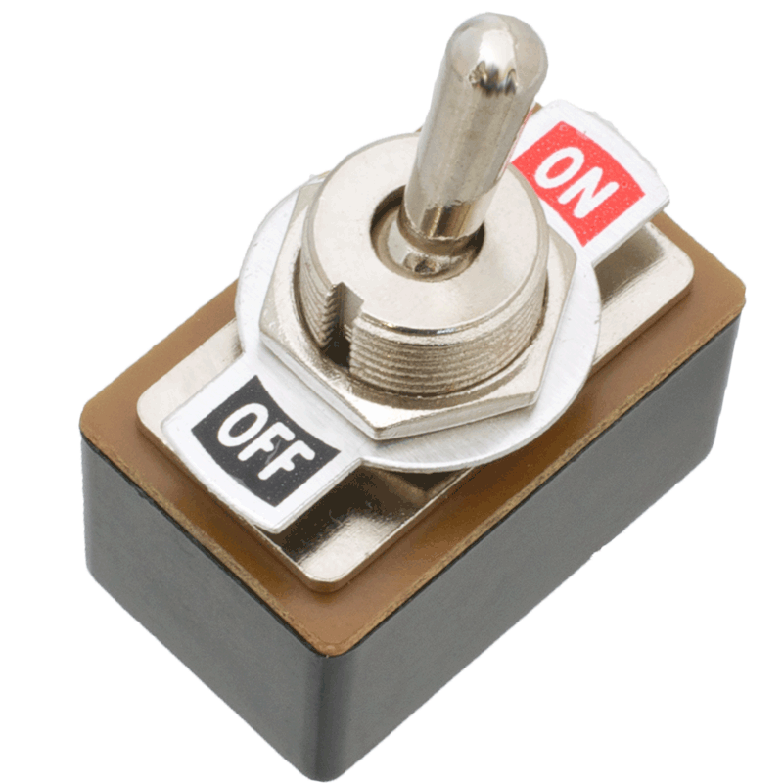
Feature toggles
What is it?
Mechanism to separate feature deployment from feature exposure
A.k.a. feature flippers, feature flags, feature switch, conditional feature, etc.
Why do you need it?
It enables you to give control back to the business on when to release the feature
Enables A/B testing, canary releases and dark launching
It provides an alternative to keeping multiple branches in version control
Enables change without redeployment

Slide 12
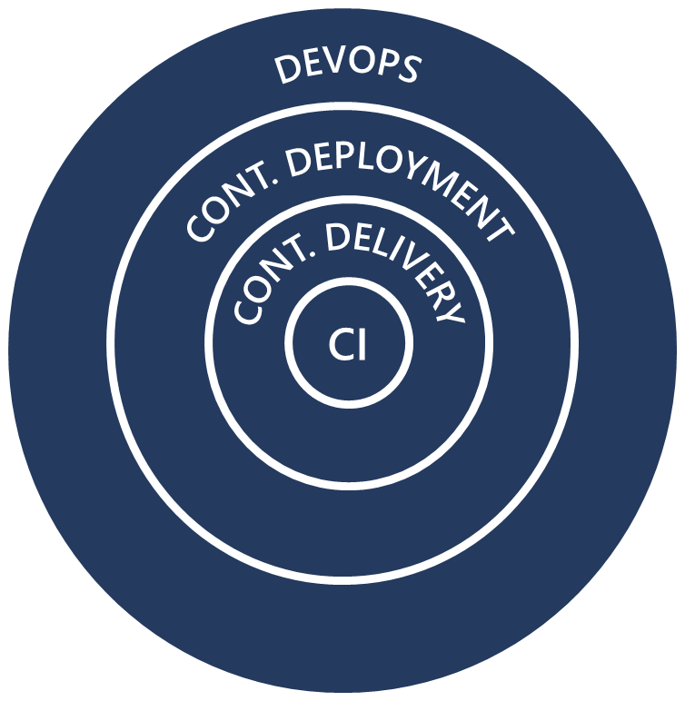
Continuous integration, delivery, deployment and DevOps

Slide 13
Discussion – What are your bottlenecks?
Discuss the need for continuous delivery in your organization and what blocks the implementation
Topics you might want to discuss are:
Does your organization need continuous delivery?
Application architecture
Do you use agile/scrum?
Skills
Is everybody involved or only the Dev departments?
Tooling
Can you deploy your application multiple times per day? Why or why not?
Tests
What is the main bottleneck for continuous delivery in your organization?
Other things?
The Organization

Slide 14
Lesson 03: Release strategy recommendations

Slide 15
Introduction and Overview

Slide 16
Artifact sources
Build artifacts
Package repositories
Container repositories
Files
Source control

Slide 17
Considerations for choosing the right artifact source
Traceability and auditability
Immutability
Versioning
Reading material

Slide 18
Selecting an artifact source
DEMO
Notes:
You can choose to play the video or present a similar demo yourself.

Slide 19
Deployment stages
What is a stage?
Many different terms used in various release tools
Stages/environment
It is a dedicated place where people can fulfill their needs
What is your target environment?
Long-lived or short-lived environments
Purpose of an environment
Feature release and bugfix

Slide 20
Discussion – What deployment stages would you define for your organization?
Discuss what deployment stages you recognize in your organization.
Consider the following things:
Is your stage long lived or short lived?
Do you need a new stage for bug fixes?
Do you need an isolated environment with encrypted data or disconnected from a network?
What is the purpose of this specific stage?
Who is going to use it?
Can you afford downtime?
Is your target application overwriting an existing one would always be a fresh install?
Who is the owner of the stage? Who can apply changes?

Slide 21
Setting up deployment stages
DEMO
Notes:
You can choose to play the video or present a similar demo yourself.

Slide 22
Delivery cadence – three types of triggers
Continuous deployment trigger
Scheduled trigger
Manual trigger

Slide 23
Considerations for cadence
Do we want/need to deploy every day?
What is your target environment?
Is it used by one team or is it used by multiple teams?
Who are the users? Do they want a new version multiple times a day?
How long does it take to deploy?
Is there downtime? What happens to performance? Are users impacted?

Slide 24
Selecting your delivery and deployment cadence
DEMO
Notes:
You can choose to play the video or present a similar demo yourself.

Slide 25
Release approvals
Release approvals are not to control *how*, but control *if* you want to deliver multiple times a day
Manual Approvals help in building trust about the automated release process

Slide 26
Considerations for manual approvals
What do we want to achieve with the approval?
Who needs to approve?
When do you want to approve?

Slide 27
Release gates
Release gates give you additional control over the start and completion of the deployment pipeline. They can usually be set up as a pre-deployment and post-deployment condition and can do validation with other automated systems until specific requirements are verified

Slide 28
Release gate examples
Incident and issues management
User experience relative to baseline
Notification of users by integration with collaboration systems
Change management
Quality validation
Infrastructure health
Security scan on artifacts

Slide 29
Setting up manual approvals
DEMO
Notes:
You can choose to play the video or present a similar demo yourself.

Slide 30
Setting up a release gate
DEMO
Notes:
You can choose to play the video or present a similar demo yourself.

Slide 31
Lesson 04: Building a high-quality release pipeline

Slide 32
Release and release process
The release pipeline contains all the steps that you walk through when you move your artifact, that comes from one of the artifact sources
A release is a package or container that holds a versioned set of artifacts specified in a release pipeline in your CI/CD process. It includes a snapshot of all the information required to carry out all the tasks and actions in the release pipeline, such as the stages (or environments), the tasks for each one, the values of task parameters and variables, and the release policies such as triggers, approvers, and release queuing options. There can be multiple releases from one release pipeline (or release process)

Slide 33
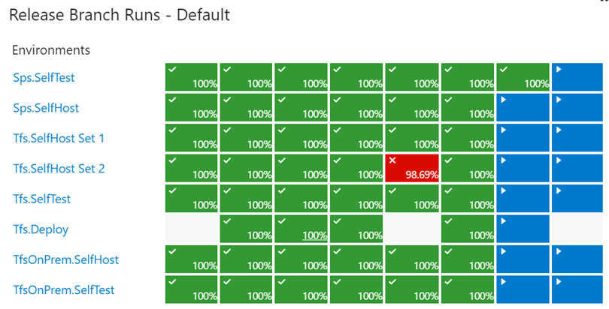
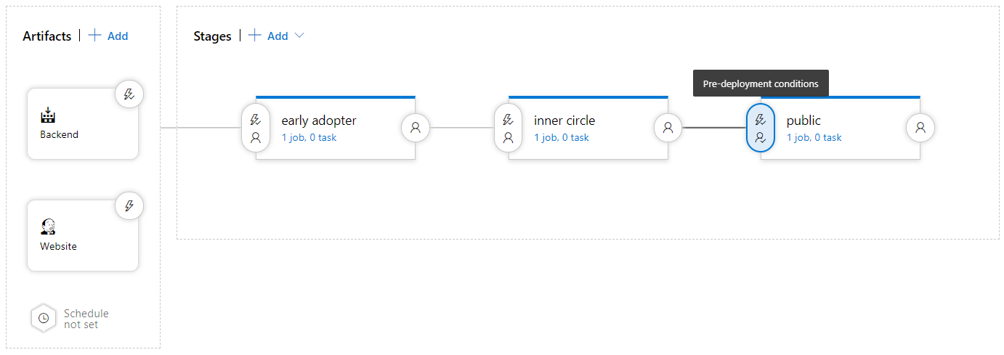
How to measure quality of your release process
Visualize your release process
Symptoms of broken process (every second day, only after rerun, never ending up in last stage)
Dashboard widgets

Slide 34

Quality gates A quality gate is the best way to enforce a quality policy in your organization. It’s there to answer one question: Can I deliver my application to production or not?

Slide 35
Using release gates to protect quality
No new blocker issues
Compliance checks
Code coverage on new code greater than 80%
Are there work items linked to the release?
Is the release started by someone else as the code committer?
No license violations
Is the performance not affected after a new release?
No vulnerabilities in dependencies
No new technical debt introduced

Slide 36
Release notes and documentation
Technical or Functional Documentation?
Where to store Documentation:
Document Store
Wiki
In the code base
In a Work Item

Slide 37
Lesson 05: Choosing a deployment pattern

Slide 38
Deployment patterns
A deployment pattern is a way of how you choose to move your application to production
Traditional Deployment Patterns (DTAP)
Dev
Test
Staging
Production
Modern deployment patterns

Slide 39
Modern deployment patterns

Slide 40
Lesson 06: Choosing the right release management tool

Slide 41
Release management tools
Tools that can do Build and Continuous Integration and Deployment
Tools that can do Release Management

Slide 42
Considerations for choosing
Artifacts and artifact source
Stages
Triggers and schedules
Build and release tasks
Approvals and gates
Traceability, auditability and security

Slide 43
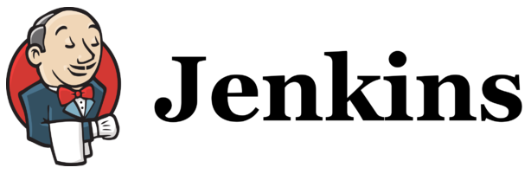





Release management tools
Jenkins
Circle CI
Azure DevOps Pipelines
GitLab Pipelines
Atlassian Bamboo
XL Deploy/XL Release

Slide 44
Lesson 07: Module review and takeaways

Slide 45
What did you learn?
Differentiate between a release and a deployment
Define the components of a release pipeline
Explain things to consider when designing your release strategy
Classify a release versus a release process, and outline how to control the quality of both
Describe the principle of release gates and how to deal with release notes and documentation
Explain deployment patterns, both in the traditional sense and in the modern sense
Choose a release management tool

Slide 46
Module review questions
1
Would adding a feature flag increase or decrease the cyclomatic complexity of the code?
2
Would adding a feature flag increase or decrease technical debt?
3
You plan to slowly increase the traffic to a newer version of your site. What type of deployment pattern is this?
4
When you want to change an immutable object of any type, what do you do?
5
What can you use to prevent a deployment in Azure DevOps when a security testing tool finds a compliance problem?
Notes:
Q1 Answer: Increase.
Q2 Answer: Increase
Q3 Answer: Blue-green
Q4 Answer: You make a new one and (possibly) remove the old one
Q5 Answer: Release gate

